Slide 1
Transient and steady state response
“I will study and get ready and someday my chance will come”
Abraham Lincoln

Slide 2
Effects of a third pole and a zero on the Second-Order System Response (cont.)
If the transfer function of a system possesses finite zeros and they are located relatively near the dominant complex poles, then the zeros will significantly affect the transient response of the system.
The transient response of a system with one zero and two poles may be affected by the location of the zero.

Slide 3
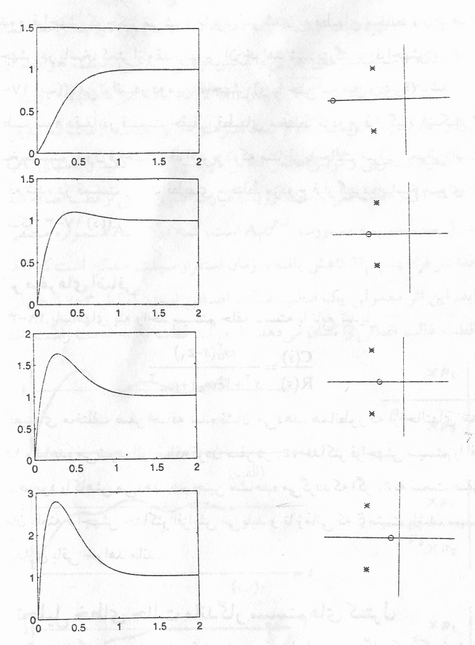
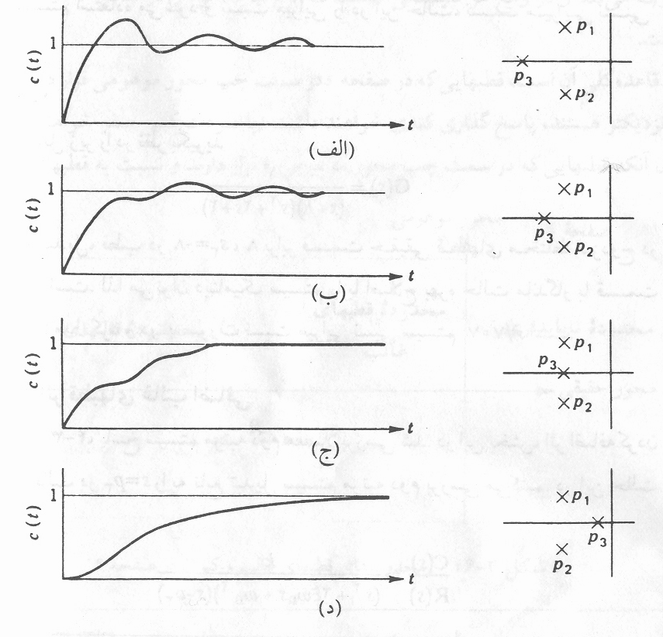
Effects of a third pole and a zero on the Second-Order System Response (cont.)

Slide 4
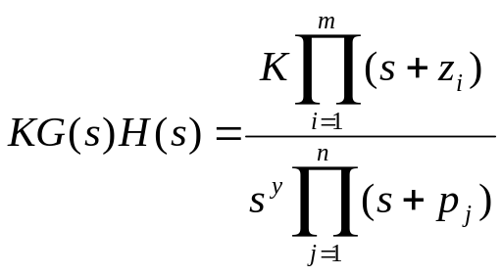
Relationship between steady state error and system type
The general form of the open loop transfer function of a system is given by
Here y is known as the system type, and it corresponds to the number of integrators in the system.
System type
We can calculate SSE for different types of standard signals
0
Type zero
1
Type 1
2
Type 2

Slide 5
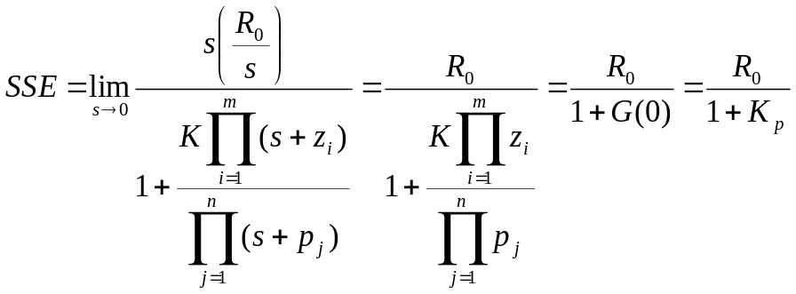
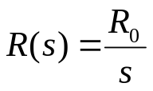

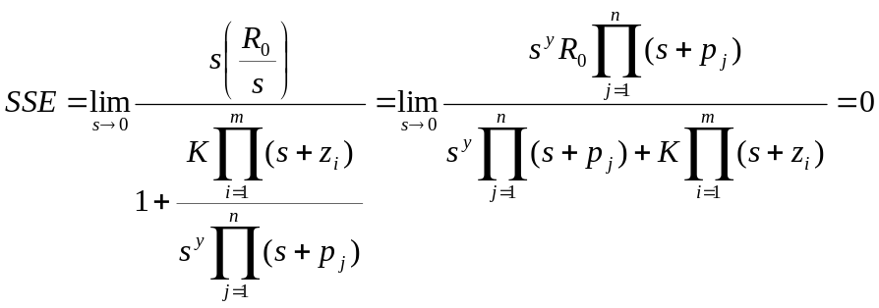
Relationship between steady state error and system type
A) Step Input
For y=0
Here is known as the position error constant.
For y>0
!

Slide 6
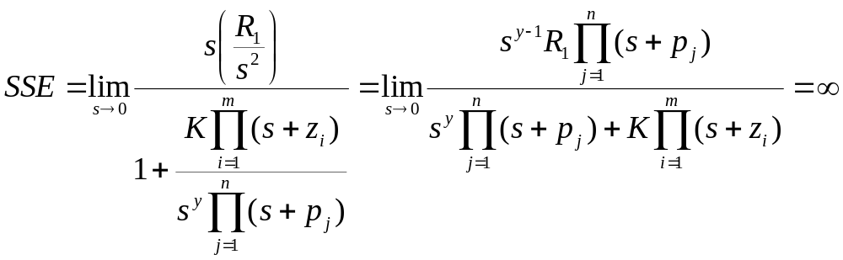
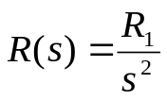
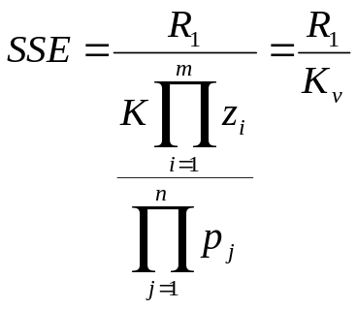

Relationship between steady state error and system type
For a type 0 system…
B) Ramp Input
For type 0 system the SSE =
For a type 1 system…
velocity constant
For the steady state error is zero.

Slide 7
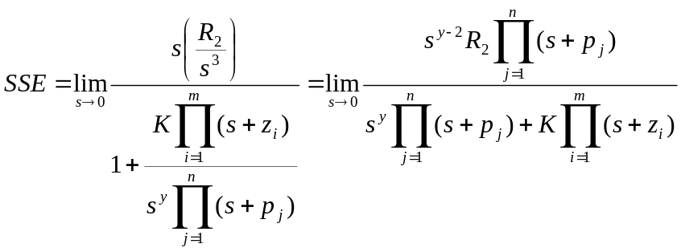


Relationship between steady state error and system type
C) Parabolic Input
For type 0 and type 1 systems, the steady state error is infinite. For type 2 systems the steady state error is given by
acceleration error constant

Slide 8




Relationship between steady state error and system type
System Type (number of pure integrators)
Input
step
ramp
parabola
0
1
2
Conclusions:
1. Adding integrators (increasing system type) eliminates steady state error.
2. If steady state error is finite and not zero, then increasing the system dc gain (increasing controller proportional gain, adding poles near the origin and/or zeros far away from the origin on the LHS of s-plane), reduces steady state error.

Slide 9
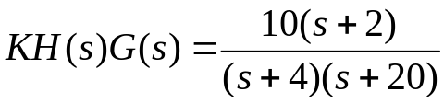
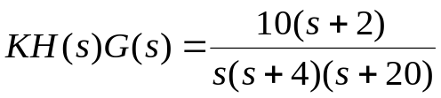
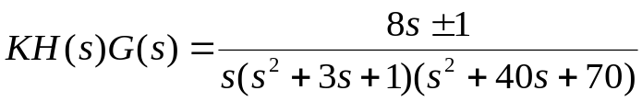
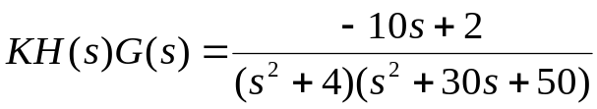
Example Problems
Calculate the open and closed loop steady errors, ramp errors, position constants or velocity constants to step and ramp inputs, respectively, for the following cases.
E(s)
R(s)
KH(s)
G(s)
Problem 1
The steady-state and ramp error computations are only valid if the closed loop is stable. Check which of these examples provides a stable closed loop.
Problem 2
Problem 3 (two problems)
Problem 4

Slide 10
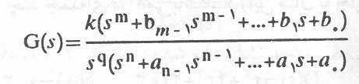
System types
Consider the unity-feedback control system with following open loop transfer function:
It involves the terms in denominator, representing a pole of multiplicity q at the origin. This present the umber of integrators.
A system is called type 0, type1, type 2, …if q=0, q=1, q=2, …, respectively.

Slide 11

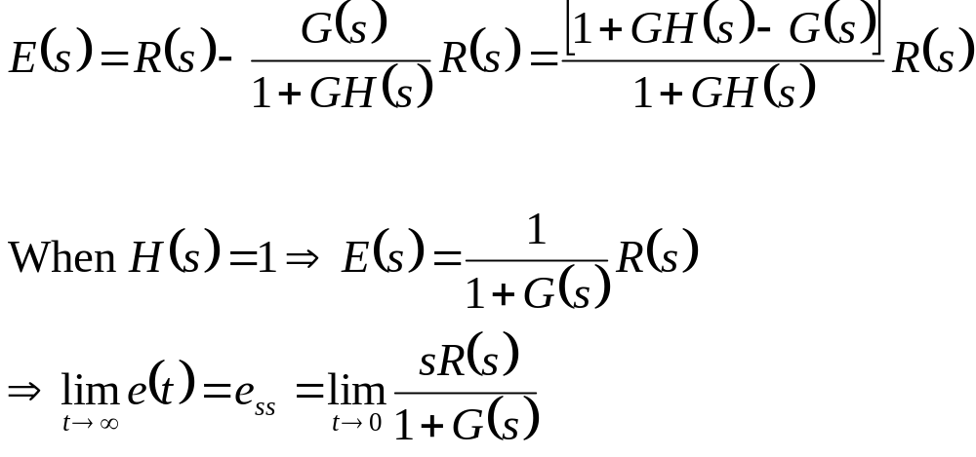
The Steady-State Error of Feedback Control Systems (importance of feedback)
The actual system error is E(s)=R(s)-Y(s)

Slide 12
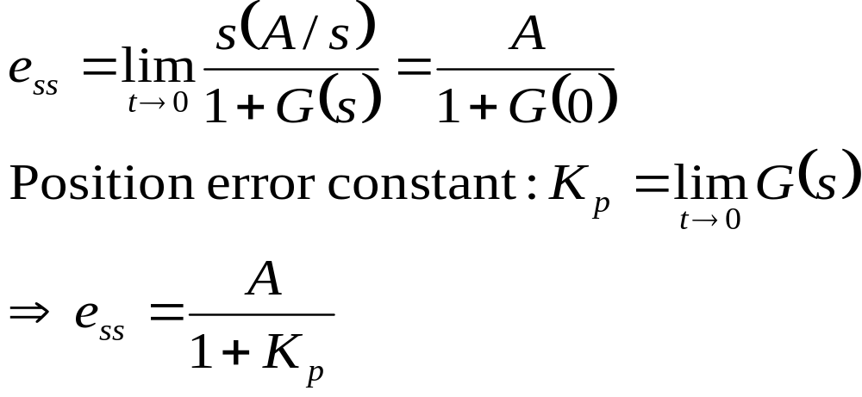
The Steady-State Error of Feedback Control Systems (cont.)
Step Input
  A is the magnitude of the input

Slide 13
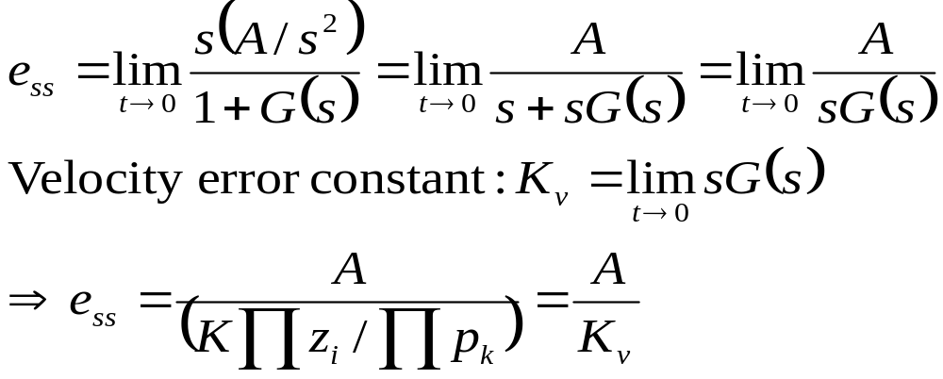
The Steady-State Error of Feedback Control Systems (cont.)
Ramp (velocity) Input
  A: the slope of the ramp
  Figure 23-3

Slide 14
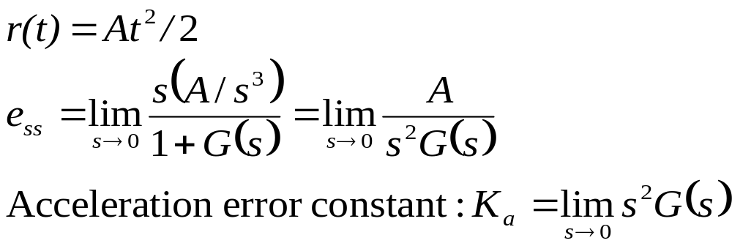
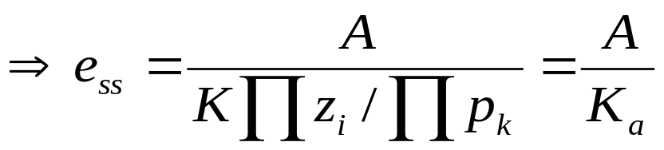
The Steady-State Error of Feedback Control Systems (cont.)
Acceleration Input
  r(t)=At²/2
  Figure 24-3

Slide 15
Effect of feedback!
Time constant (rate of sytem response)
  How to make it smaller or bigger by feedback using!
External disturbance
  Always living in our systems!
  Two type
    Load dist. Or offset
    Random noise
  SNR: signal-to-noise-ratio
Sensitivity

Slide 16
Sensitivity of Control Systems to Parameter Variations
With an open-loop system, all changes and errors at the output are ignored, resulting in a changing and inaccurate output.
A closed-loop system senses the changes in the output and attempts to correct the output.
The sensitivity of a control system to parameter variations is very important.
  A closed-loop system can reduce the system’s sensitivity.

Slide 17
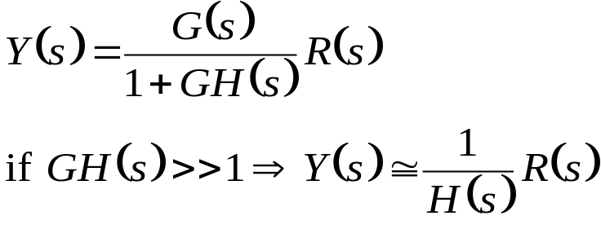
Sensitivity of Control Systems to Parameter Variations (cont.)
For the closed-loop case:
      The output is only affected by H(s).
      If H(s)=1, we have the desired result
Caution: The requirement that GH(s)>>1 may cause the system response to be highly oscillatory and even unstable.
As we increase the magnitude of the loop transfer function G(s)H(s), we reduce the effect of G(s) on the output.
The first advantage of a feedback system is that the effect of the variations of the process, G(s), is reduced.

Slide 18
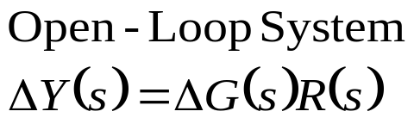
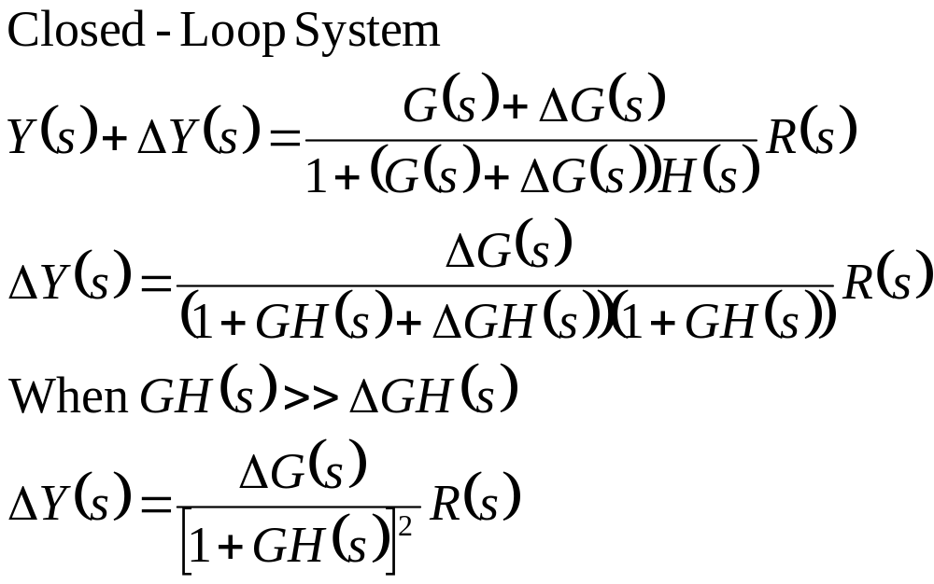
Sensitivity of Control Systems to Parameter Variations (cont.)
Illustration of the parameter variations
  Let’s consider a change in the process so that the new process is G(s)+ΔG(s).
  The change in the transform of the output is

Slide 19
Sensitivity of Control Systems to Parameter Variations (cont.)
For the closed-loop system
  The change in the output of the closed-loop system us reduced by the factor [1+GH(s)]
  This is usually much greater than 1 one the range of complex frequencies on interest.

Slide 20
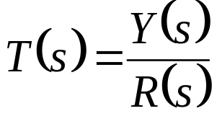
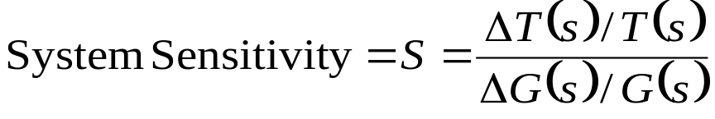
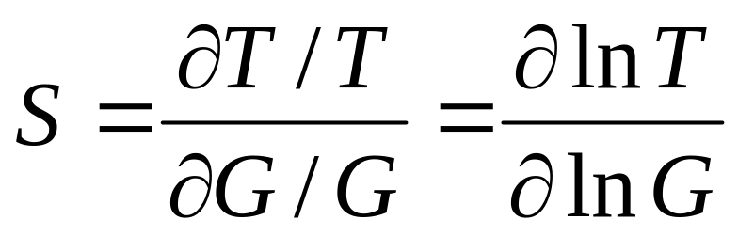
Sensitivity of Control Systems to Parameter Variations (cont.)
The system sensitivity
  System Transfer Function is
For small incremental changes:

Slide 21
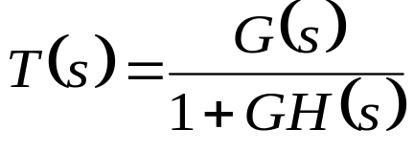
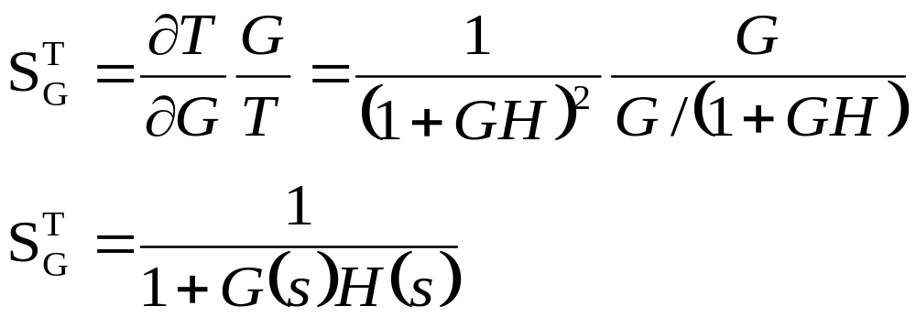
Sensitivity of Control Systems to Parameter Variations (cont.)
The system transfer function of the closed-loop system is:
The sensitivity of the feedback system is:
  The sensitivity of a system may be reduced below that of the open-loop system by increasing GH(s) over the frequency range of interest.

Slide 22
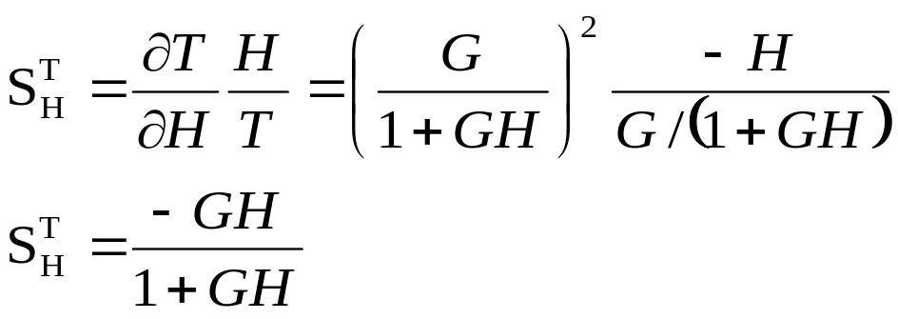

Sensitivity of Control Systems to Parameter Variations (cont.)
The sensitivity of the feedback system to changes in the feedback element H(s) is:
  When GH is large, the sensitivity approaches unity (1)
  The changes in H(s) directly affect the output response
It is important to use feedback components that will not vary with environmental changes or that can be maintained constant.

Slide 23
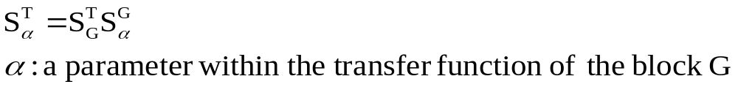
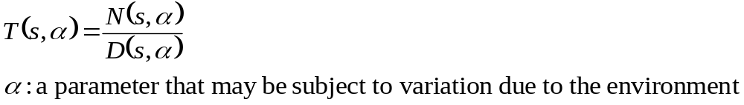
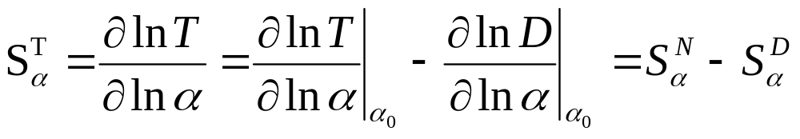
Sensitivity of Control Systems to Parameter Variations (cont.)
The sensitivity to α:
The transfer function of the system T(s) is a fraction of the form
The sensitivity to α:
  α is a nominal value of the parameter

Slide 24
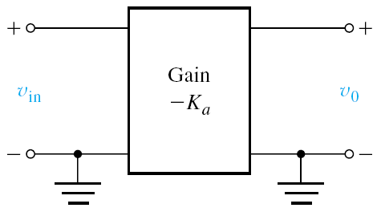

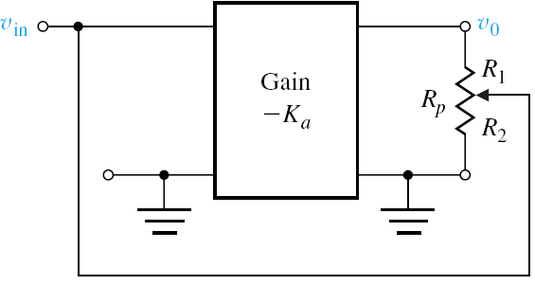
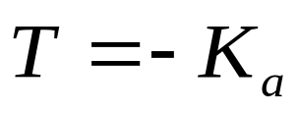
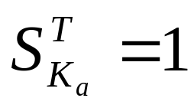
Sensitivity of Control Systems to Parameter Variations (cont.)
  -K_{a}: gain of amplifier
  Output voltage:
  We add feedback using a potentiometer R_{p}.
  The transfer function of the amplifier without feed back is:
  The sensitivity to changes is the amplifier gain is:

Slide 25
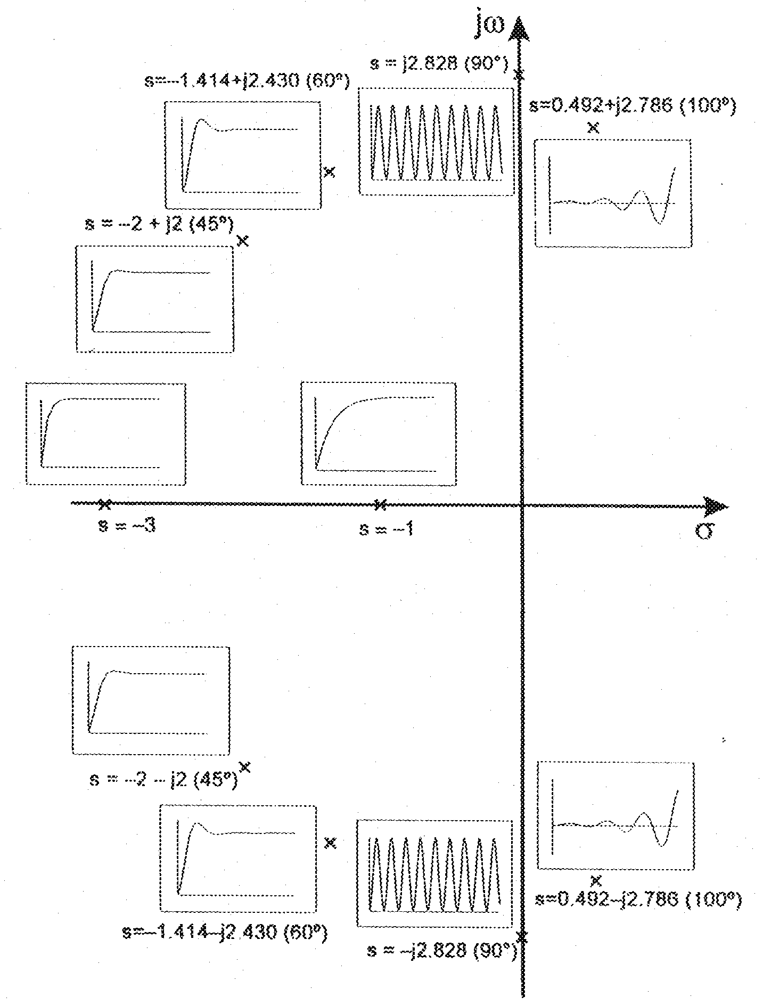

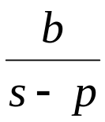
STABILITY
Examining the closed loop poles
The zeros of the denominator
will determine the impulse and step response stability.
The inverse Laplace transform applied to
gives time signal
For stability all closed loop poles must have negative real parts.

Slide 26
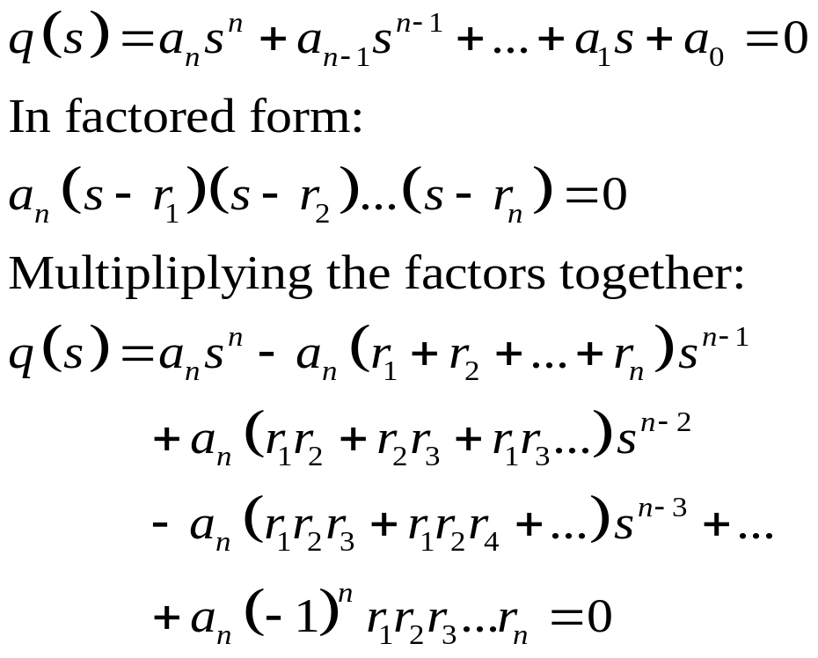
Routh-Hurwitz Criterion Procedure
The characteristic equation in the Laplace variable is:

Slide 27
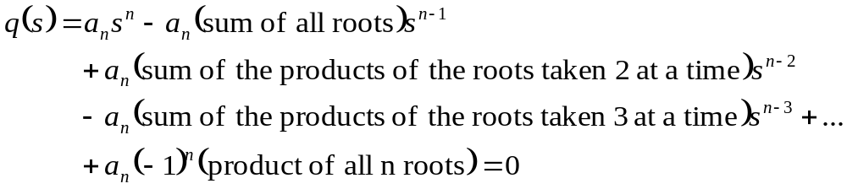
Ruth-Hurwitz Criterion Procedure
For the nth-degree equation:
  Note that all the coefficients of the polynomial must have the same sign if all the roots are in the left-hand plane.
  For a stable system all the coefficients must be nonzero.
  Both of these requirements must be sufficient for the system to be stable.
  If the are satisfied we can proceed to check for other conditions to prove that the system is stable.

Slide 28

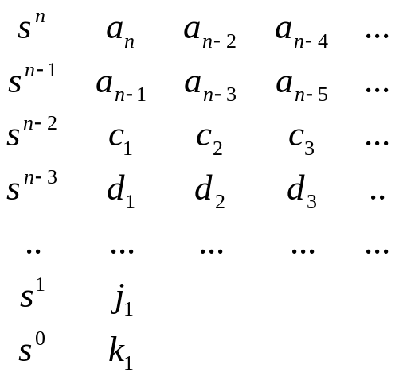
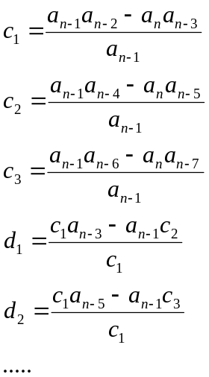
Ruth-Hurwitz Criterion Procedure
Does this equation have only stable roots?
(I.e do all solutions have negative real parts? )
For first and second order systems (n=1,2) the necessary and sufficient condition for stability is that the coefficients of the polynomial are non-zero and all have the same sign.
For higher order
systems produce
this table

Slide 29
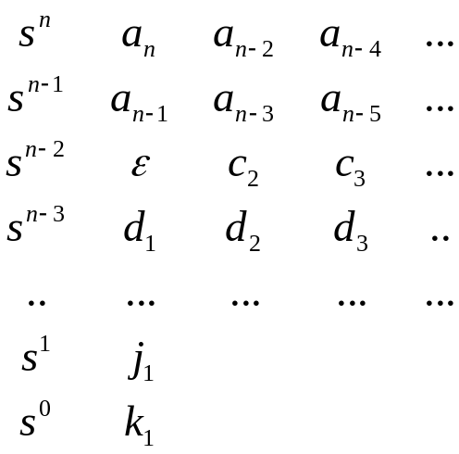

Ruth-Hurwitz Criterion Procedure
Case 2 : there is a zero in the first column but that row is not zero everywhere
Replace the 0 by a small positive and carry on in the usual way
zero replacement
Again the number of sign changes in the first column will determine the number of unstable zeros.
Product polynomial at (s+1) start roth table
Replace s with 1/x

Slide 30
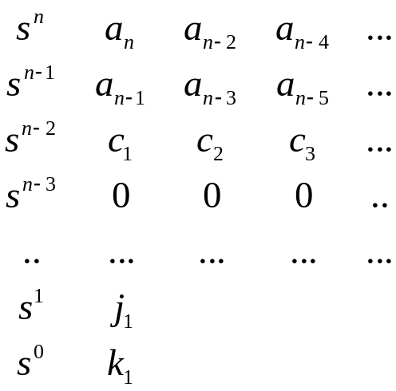

Ruth-Hurwitz Criterion Procedure
Case 2 : there is a zero in the first column and that row is zero everywhere
auxiliary polynomial is
zero row
The auxiliary polynomial (order is always even) gives the number of symmetrical root pairs (to the origin).
It divides the polynomial and long division can be used to obtain the other factor.
For the rest of this class practice the application of the Ruth-Hurwitz procedure to decide on stability for as many of the examples as you can.
(The solutions involve the computation of the closed loop transfer functions first .)

Slide 31
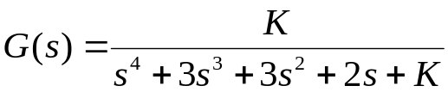
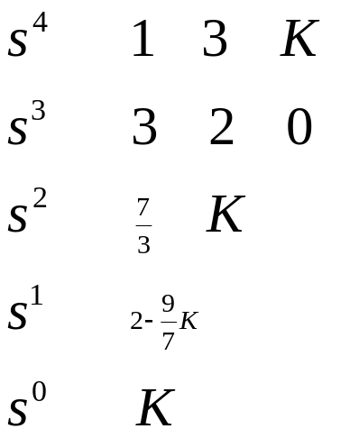
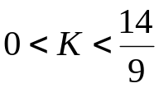
Examples: Ruth-Hurwitz criterion procedure
Example 2
Condition of stability:

Slide 32

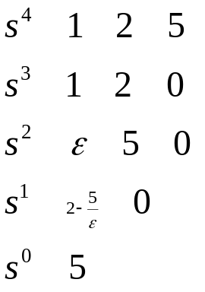
Examples: Ruth-Hurwitz criterion procedure
Example 3 : zero in first column (but not all zero in row)
small positive
number
large negative number

Slide 33

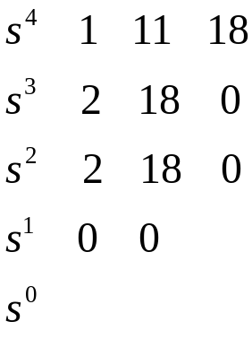
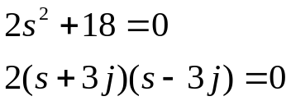


Examples: Ruth-Hurwitz criterion procedure
Example 4 : a zero row
Coefficients for auxiliary equation
zero row
Long division of original polynomial by auxiliary polynomial:
Conclusion: unstable

